Slide 1

Web-Scraping Project:
Identifying Stroke Outcome Measures
Using Rehabilitation Measures Database
MJ Lee
07.25.2021

Slide 2
My Goal
Something useful for my work
Meet the requirement of the project

Slide 3
Background
According to the Agency for Healthcare Research and Quality, patient outcome measures mirror therapeutic improvement of healthcare services or interventions [1].
The act of measurement aims to enhance the quality of decisions by providing feedback to clinicians on their therapeutic actions [2].
Measuring health outcomes allows clinicians to identify the effective health programs and resources for improved accountability in patient results [3].
In other words, patient outcome measures are fundamental tools to evaluate the results of healthcare services [4,5].
Therefore, selecting the optimal outcome measure for each patient’s goal is central in providing health services.

Slide 4
Problem Statement
Despite a number of readily available patient measures, whether the breadth of the measures is sufficiently comprehensive to encompass all critical constructs for specific populations is unknown.
For example, 124 measures were searched for stroke population, but there was only one measure for evaluating eating, and this measure has not been tested with acute stroke patients.
It is possible that certain areas might have been neglected from healthcare services because they were not included in outcome measures.

Slide 5
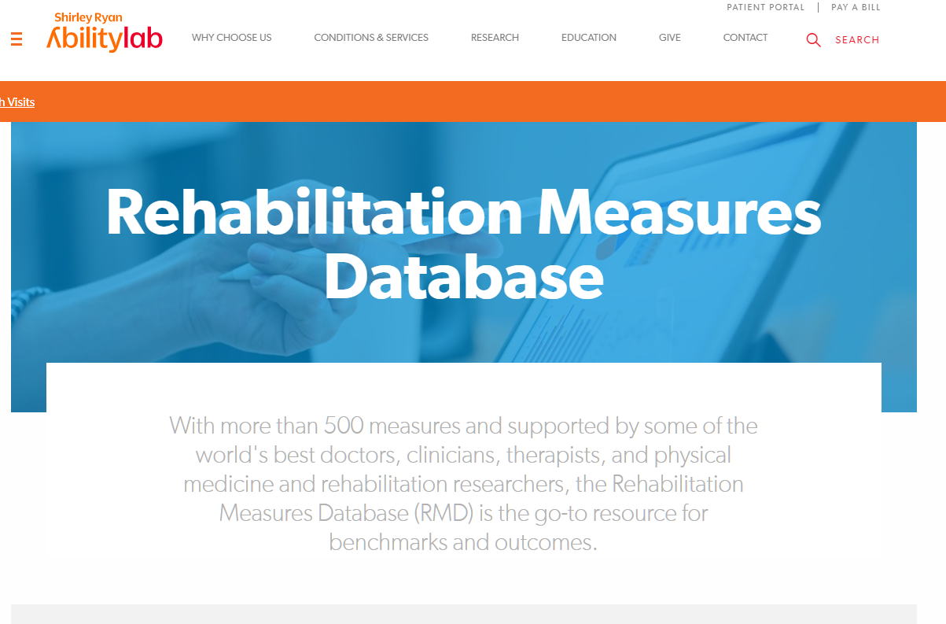
My Interest
Rehabilitation Outcome Measures
Rehabilitation Measures Database (RMD)
-> 500 patient measures
Domains, International Classification of Functioning, Disability and Health (ICF), Cost, Type, Reliability, Validity, Time, others.
Stroke, Spinal Injuries, Brain injuries, Parkinson’s disease, Neuromuscular conditions, Vestibular disorders, older adults and geriatric care, Cancer, Musculo Skeletal Conditions, Arthritis

Slide 6
Objectives
MJ: Examine and summarize existing outcome measures of stroke patients in order to investigate the scope of currently available constructs
NYCDSA Project: Scraping information from the web, cleaning it and gathering insights from it.
Target Audience: PM&R Clinicians and Rehabilitation Researchers

Slide 7
The Purpose of This study is To
discuss all essential areas of outcome measures for stroke patients through web-scraping RMD.

Slide 8
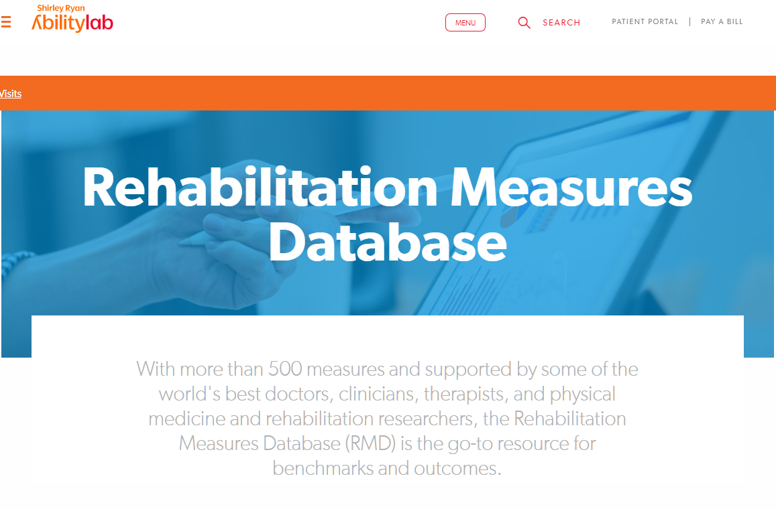
Methods
Python, Scrapy, R ggplot2
11 pages of the stroke section
Scraped measure domains and ICF domains
Measurement domains were extracted and summarized using counts and percentages.

Slide 9
Results
ICF
'Activity': 77 (41%), 'Body Function': 50 (27%), 'Participation': 32 (12%), 'Environment’: 7 (4%), 'Body Structure': 22 (17%)
Domains
'Activities of Daily Living': 39 (23%), 'Motor': 65 (38%), 'General Health': 21 (12%), 'Cognition': 18 (11%), 'Emotion': 13 (8%), 'Sensory': 10 (6%), 'Participation & Activities’: 3 (2%)

Slide 10
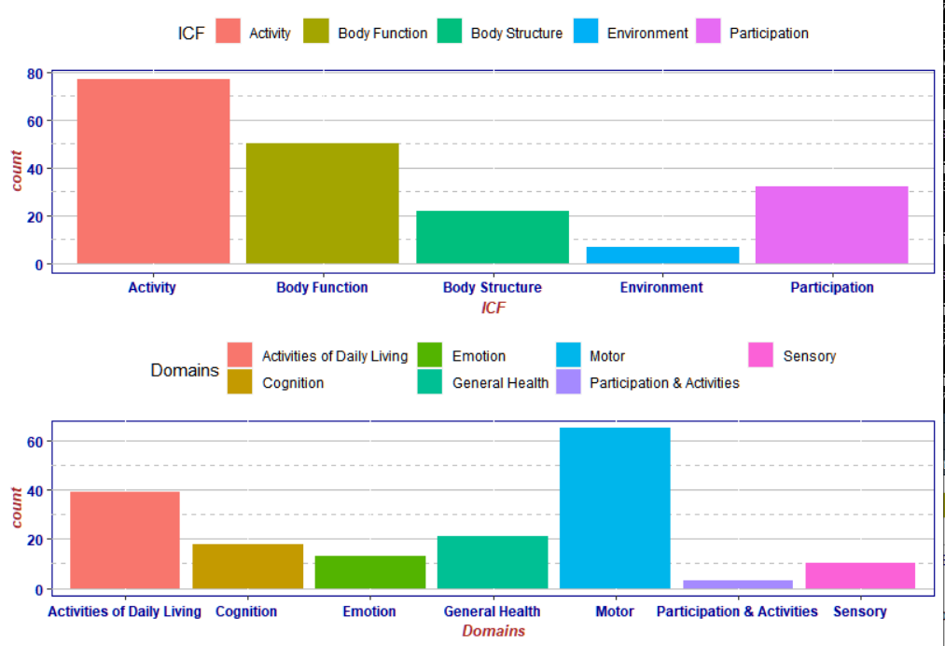
Results

Slide 11
Discussion
We may have neglected incorporating patients’
Environmental factors
Cognition
Emotion
In developing therapeutic interventions tailored to each patient.
We need to examine qualities of the measures.

Slide 12
Use of This Study
An abstract to American Congress of Rehabilitation Medicine (ACRM) has been submitted.
If admitted, a scientific poster will be presented this result in the ACRM 2021.
Currently, working on a manuscript with extended results (e.g., cost, mode, price, etc.), aiming to submit one by the end of August.

Slide 13
Acknowledgment
This research was supported in part by grant# K12 HD055929 from the National Institutes of Health (NIH). Its contents are solely the responsibility of the authors and do not necessarily represent the official views of the NIH.
NYCDSA Alex Baransky for advising the workflow.

Slide 14
References
1. Types of Health Care Quality Measures | Agency for Health Research and Quality. https://www.ahrq.gov/talkingquality/measures/types.html.
2. Smith, P. C., Mossialos, E. & Papanicolas, I. Performance measurement for health system improvement: experiences, challenges and prospects. 28.
3. Grossman, C. & Alper, J. Observational studies in a learning health system: workshop summary; 2013 Apr 25-26. (Washington, DC. Washington: National Academies Press, 2013).
4. Pantaleon, L. Why measuring outcomes is important in health care. J. Vet. Intern. Med. 33, 356–362 (2019).
5. Porter, M. E. Measuring health outcomes: the outcomes hierarchy. N Engl J Med 363, 2477–81 (2010).

Slide 15
Thank you

